Slide 1
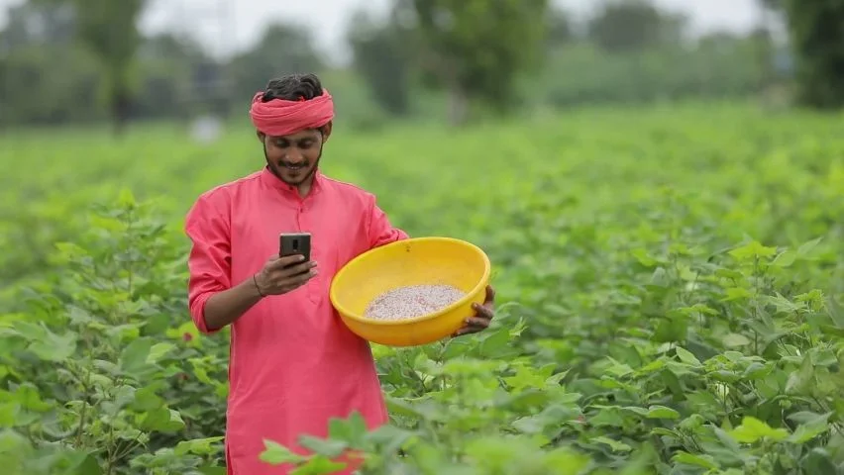
HELPAL
PI DECK

Slide 2
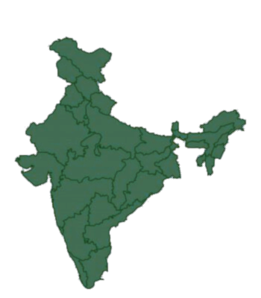
5 million
hectares of land with crop lost in India due to unexpected rain just in 2021

Slide 3
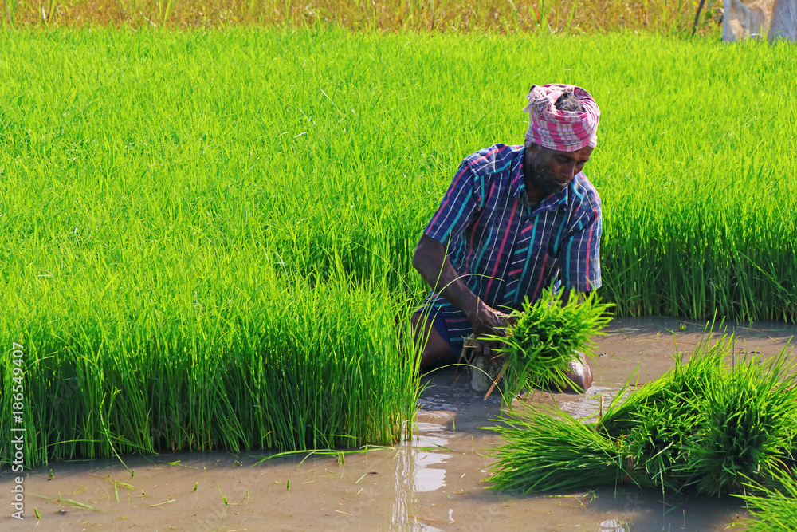
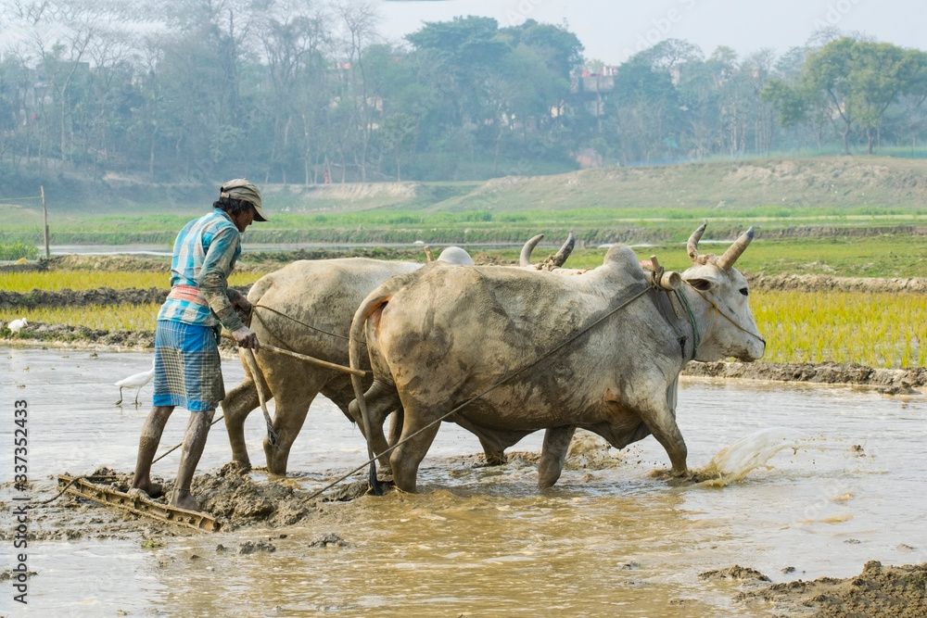
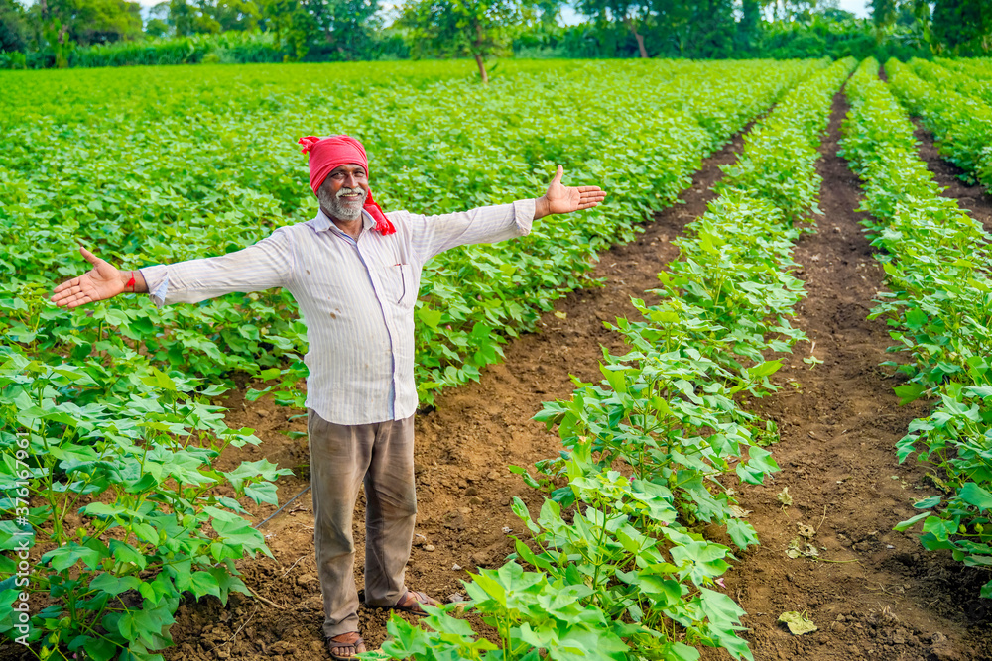
WHAT HELPAL WANTS TO DO
EDUCATED FARMER
SUICIDE RATE
IMPORTED FOOD & REPAIRS
180,000 farmers in Maharashtra committed suicide in last 2 decades
cost government $600.000.000

Slide 4


EXISTING SOLUTIONS
There is no teacher?
Look at all these features
EDUCATION
TOO COMPLEX
FLOOD WARNING SYSTEM
NO TRAINING PROVIDED

Slide 5

Language option
Expert Guidance
Get training and data in regional language
Get feedback on your training activities
Audio
Support and help
Use audio button for accessing the app
Onsite help if needed
45$
PREMIUM
10$
20$
BASIC
PRO
Training + Support + Rewards + Alert warning notification + Buying equipment
Video based tutorials
Video + App training

Slide 6
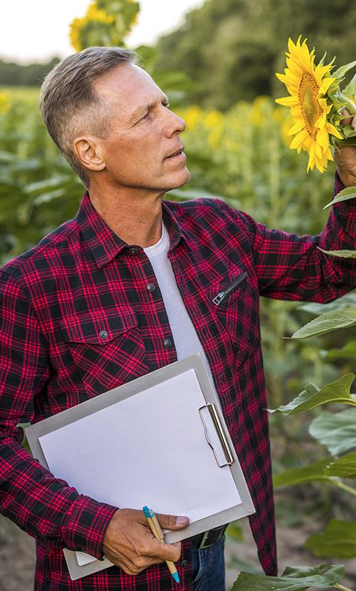
PRODUCT DEMO

Slide 7
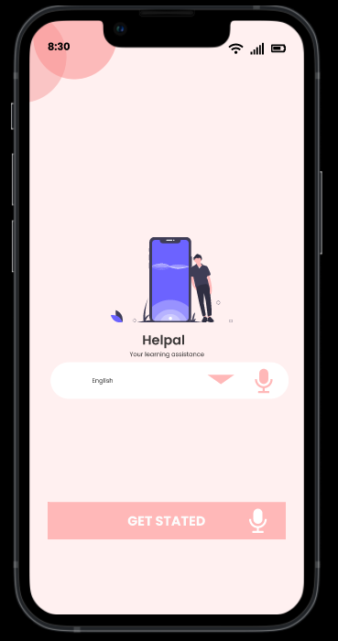
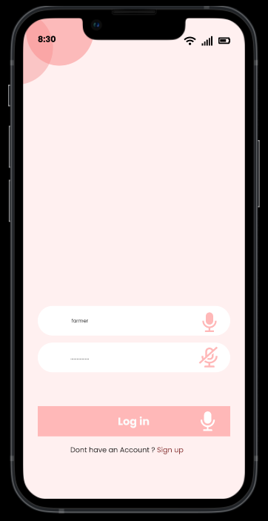

Slide 8
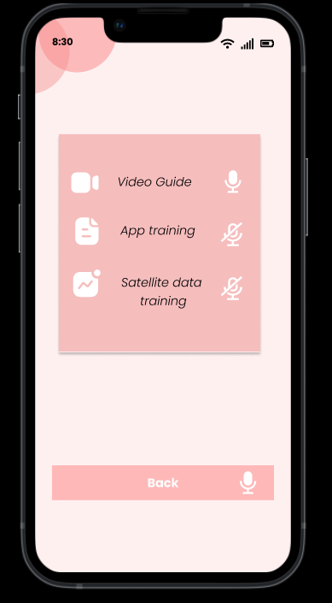
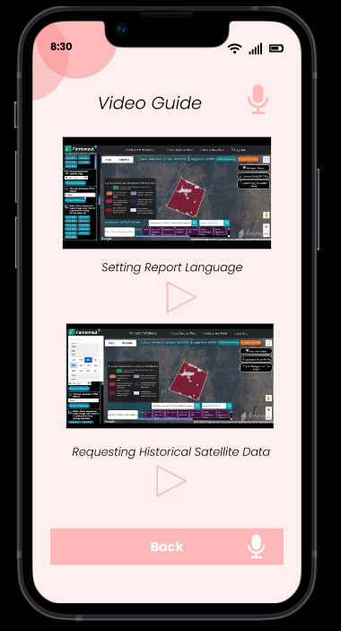

Slide 9
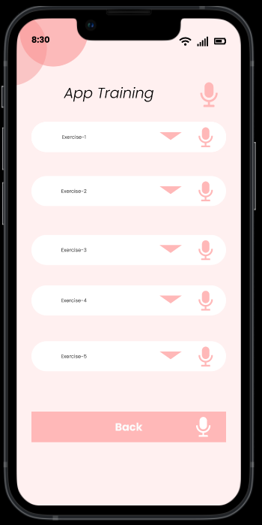

Slide 10
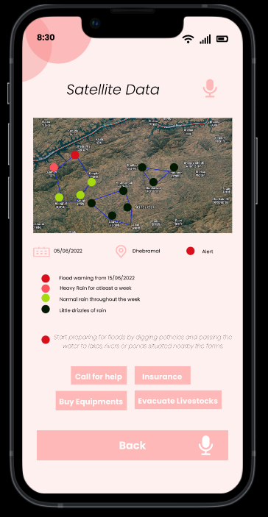

Slide 11
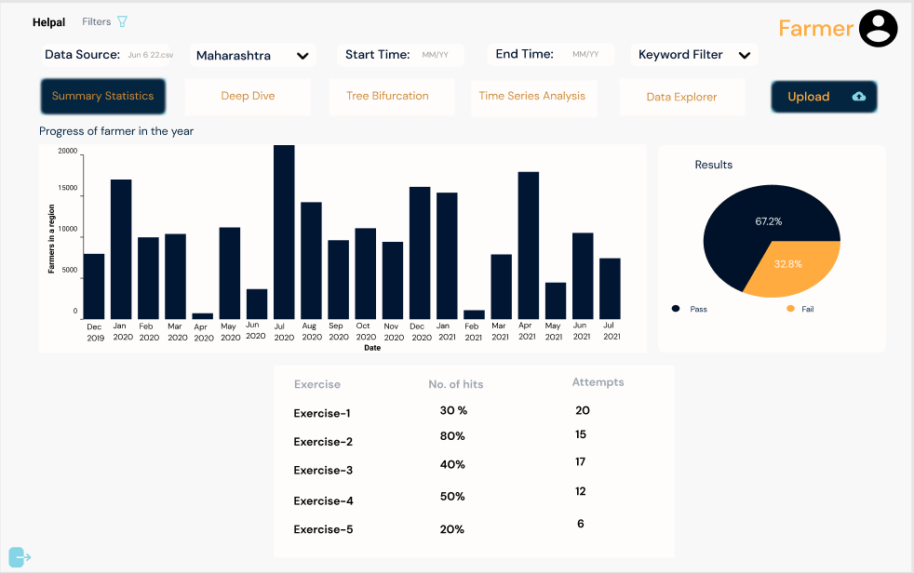

Slide 12
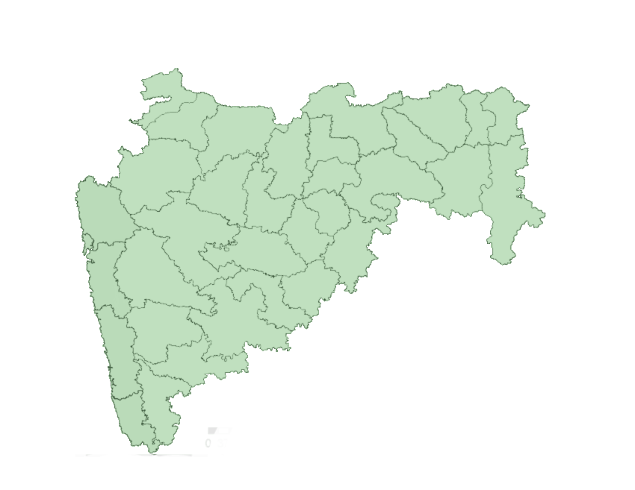
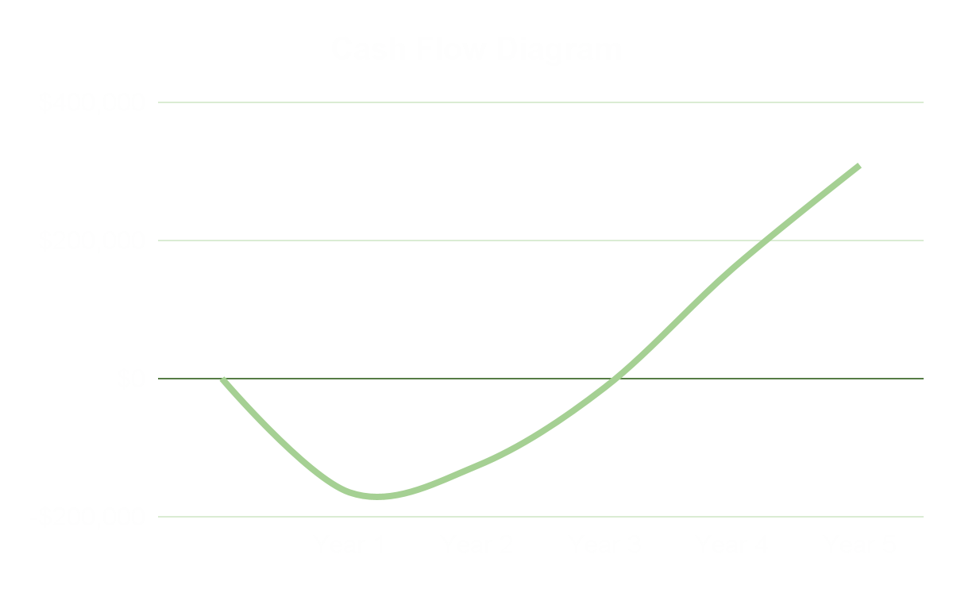
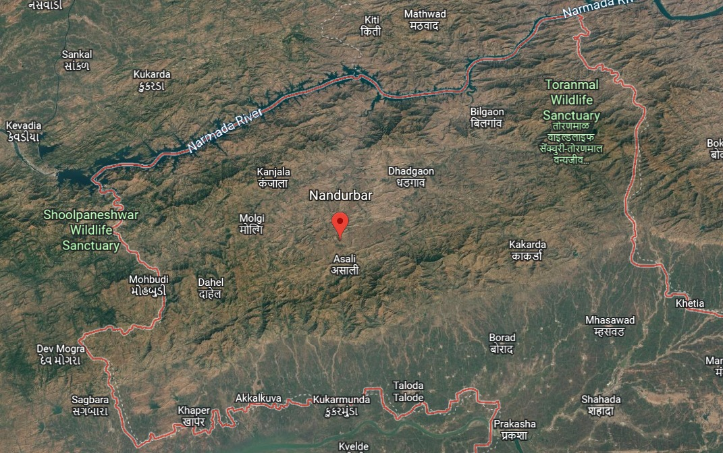
83, 300
farmers / month had damaged crop
MAHARASHTRA
Nandurbar: our market to start

Slide 13




CUSTOMER
PHASE 1
PHASE 2
GOVERNMENT
COMPANIES

Slide 14


OUR TEAM
SHRUTI PISTOLWALA
KATERINA KOBRLOVA
Rapid Prototyping
Smart Collaborator

Slide 15


SCAN QR CODE
and check out the prototype!

